Slide 1
Policy Update
NW Portland Area Indian Health Board
Quarterly Board Meeting
January 24, 2013

Slide 2
Overview
Contract Support Costs
FY 2013 IHS Budget & Sequestration
Medicaid: Proposals to Reduce
Uncompensated Care Model
TTAG/MMPC Updates
Discussion

Slide 3
FY 2015 Budget Formulation
Budget meeting Nov. 8-9, 2012; Seattle, WA; 41 tribal attendees
Portland Tribes recommended increases at 17% ($751 mil.) and 5% ($221 mil.)
Health Priorities remained the same
Program priorities within line item recommendations:
  HP/DP: $30 million
  Chronic Disease: $130 million
  H&C, MH & A/SA, UIHP, facilities’ accounts

Slide 4
Summary of Portland Area Recommendations – FY 2015
 | 17% | 5%
Federal & Tribal Pay Cost Increases | $34.6 million | $34.6 million
Non-Medical Inflation | $28.6 million | $14.3 million
Medical Inflation | $131.8 million | $65.9 million
Population Growth | $49.1 million | $49.1 million
Contract Support Costs | $ 130 million
Total Current Service & CSC Amounts | $374.1 million | $163.9 million
Total Increase | $751.8 | $221

Slide 5
IHS FY 2013 Appropriation:
Still no Final Appropriation
FY 2013 President’s request $115 million increase for IHS
House Interior Subcommittee approved bill includes $186 million increase for IHS
  The Full House has not acted
Senate Interior Committee released FY 2013 Interior-Related Agency bill includes $85 million
Looming issue of Debt Reduction, Debt Ceiling and Sequestration
  Jan. 3rd deal to postpone Sequestration until March
  Deficit reduction to include mix of Revenues & Spending Cuts

Slide 6
IHS Budget & Sequestration
Budget Control Act of 2011 reduces deficit by $2.3 trillion over 10 years thru two vehicles
  Caps in discretionary spending $841 billion over 10 years
  Super Committee Deficit Reduction Plan
  If Plan not adopted allows process Sequestration
Sequestration
  Not new, Gramm Rudman, mandates automatic across-the-board spending cuts
  Initial analysis indicated that IHS programs would be protected by provision in Gramm Rudman Act
  This would have held IHS harmless up to a 2% reduction
  OMB Report indicates that “IHS funds are subject to full sequestration”

Slide 8
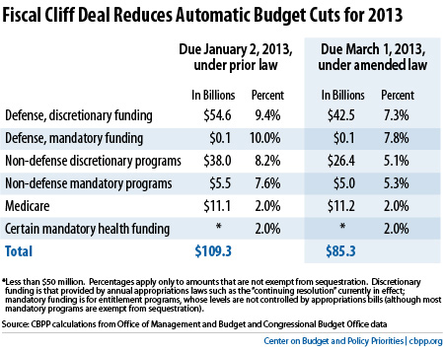

Slide 9
Medicaid: Budget Reduction
Medicaid will be target in Budget Reduction debate
  Feds pay 57% of costs; and is 8% of total federal spending; cuts proposed:
  Nat’l. Commission $58 billion/10 yrs
  President’s 2013 request $56 billion/10 yrs
  Ryan Plan $1.4 trillion over 10 years
  CBO “Choices for Deficit Reform”: convert LTSS in block grant; repeal Expansion; reduce FMAP floor - $156 billion/10yrs

Slide 10
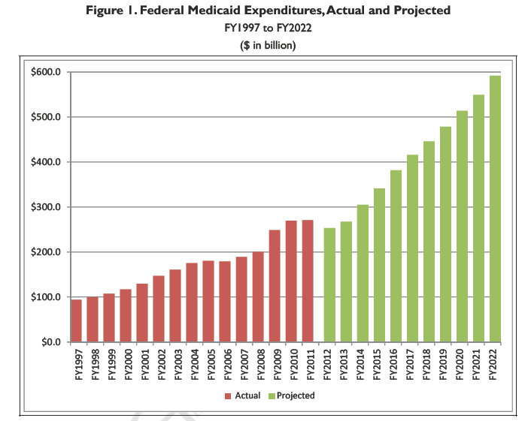

Slide 11
Important to Note for AI/AN
  Approximately 30-50% of current IHS users are on Medicaid
  Medicaid Expansion will see this grow to as high as 75% of IHS Users on Medicaid
  Portland Area Users ~30%; estimated to grow to ~60-70%

Slide 12
FMAP Exceptions reported by CRS
Proposals to reduce FMAP: Blended FMAP, Reduce FMAP Floor, Establish FMAP Ceiling
  Major and state-wide disasters
  Enhanced FMAP (E-FMAP) for covering breast and cervical cancer
  States receive 100% FMAP for AI/AN services
  States receive 90% FMAP for family planning
  States receive 50% FMAP for administrative costs of managing program

Slide 13
Summary of CRS Medicaid Proposals to Reduce Costs
FMAP changes
  Floor/Ceiling changes
  Eliminate exceptions for enhanced FMAP
Eliminate Managed Care Barriers
  States can not mandate enrollment for duals, AI/AN, and children w/special need
Eliminate/reduce DSH allotments
Limit DME

Slide 14
Idaho Updates
Medicaid Expansion
  Workgroup Report unanimously supports Expansion with conditions
    Personal Accountability and Redesign of Medicaid health care system
  75% of DHW Budget is spent on Medicaid
Jan. 10th State of State Address, Governor reported he will not expand
Idaho proposed partial expansion, Feds denied (December Guidance)
Idaho may expand and can later drop
Pending interaction between Idaho Medicaid and Feds about expansion

Slide 15
Idaho Update: Insurance Exchange
Signed Executive Order blocking Exchange – halted $21.3 million establishment grant
Appointed workgroup to develop recommendations & “move forward”
December 11th, Idaho Governor reported State will develop Exchange
Legislature must now develop bill to support Idaho Exchange – Previous bill failed in 2012 session
Jan. 3rd, CCIIO conditional approval of Idaho’s Exchange Blueprint
  Full approval contingent on meeting certain requirements by February 15, 2013

Slide 16
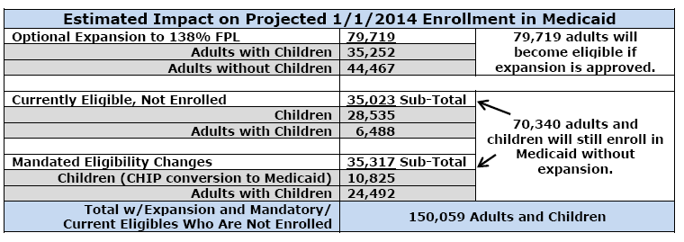
Projections from Idaho Medicaid Expansion

Slide 17
Uncompensated Care Update
Project follows AZ 1115 Waiver to exempt AI/AN from benefits & eligibility restrictions
Draft “paper” developed by workgroup
States in discussion with CMS about how to proceed
Key elements include:
  Waiver FFS versus uncompensated care model
  Will it apply to ACA Medicaid expansion group
  Due to 100% FMAP will be limited to IHS and Tribal Programs; will need UIHP to support
  Benefit Design and base year; MH & LTC services
  Non-eligibles, and 100% FMAP
  Tribal non-federal share options
  Reimbursement mechanism
  Program capacity and surge concerns by CMS

Slide 18
MMPC/TTAG Issues
ACA Implementation:
  Regulations, FFE, IHS/VA agreement, Indian definition, IRS subsidies, OPM Multi-state plans
CMS Tribal Consultation Policy
Data
TTAG Outreach & Eduction
Long-Term Care
Medicaid Expansion issues
Medicaid Administration Match – “Again”
CMS-TTAG Strategic Plan

Slide 19
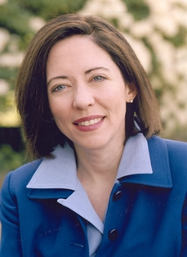
Senate Committee on Indian Affairs: Sen. Maria Cantwell, Chair
Sen. Maria Cantwell (D-WA) selected by the Democratic Steering Committee to serve as Chair of Indian Affairs.
“I am honored to be selected to chair the Senate Indian Affairs Committee. I am proud of my work with Washington state Tribes, on issues such as self-determination, education, health care and environmental issues including salmon restoration. I would be proud to serve as the first female chair of the Senate Indian Affairs Committee.”
Notes:
Key issues for new chair:
Indian Definition Fix
Amendments to IGRA and on-line gaming bill
VAWA
Carceri Fix

Slide 20
Questions/Discussion
Jim Roberts, Policy Analyst
Northwest Portland Area Indian Health Board
jroberts@npaihb.org

Slide 21
IHS FY 2013 President’s Request
Current Services: $85.6 million
  Federal Pay Costs $2.4 million
  Medical Inflation $33.9 million
  Staffing new facilities $49.3 million
Program Increases (Reprogramming)
  CHS increase $20 million
  HIT ICD-10 $6 million
  Direct Operations $1.1 million
  Contract Support Costs $5 million
  Maintenance & Improvement $1.5 million
  Health Facilities Construction $3.6 million

Slide 22
IHS Budget 2013
Background Information

Slide 23
Indian Health Service FY 2013 Budget Comparing President's Request, House and Senate Action Prepared by: NW Portland Area Indian Health Board - 9/28/2012
 | PRESIDENT'S REQUEST |  |  |  | HOUSE ACTION |  |  |  |  | SENATE ACTION
Sub-Sub Activity | FY 2012 Final | President's FY 2013 Request | Change over FY 2012 | Pct. Of Change | House Action H. Rpt. 112-589 | Change over FY 2012 | Pct. Of Change | Change over Request | Pct. Of Change vs. Request | Senate Action Rpt ### | Change over FY 2012 | Percent of change | Change over Request | Pct. Of Change vs. Request
Hospitals & Health Clinics | $ 1,810,966 | $ 1,849,310 | $ 38,344 | 2.1% | $ 1,851,448 | $ 40,482 | 2.2% | $ 2,138 | 0.1% | $ 1,852,948 | $ 41,982 | 2.3% | $ 3,638 | 0.2%
Dental Services | $ 159,440 | $ 166,297 | $ 6,857 | 4.3% | $ 166,597 | $ 7,157 | 4.5% | $ 300 | 0.2% | $ 166,297 | $ 6,857 | 4.3% | $ - | 0.0%
Mental Health | $ 75,589 | $ 78,131 | $ 2,542 | 3.4% | $ 78,131 | $ 2,542 | 3.4% | $ - | 0.0% | $ 78,131 | $ 2,542 | 3.4% | $ - | 0.0%
Alcohol & Substance Abuse | $ 194,297 | $ 195,378 | $ 1,081 | 0.6% | $ 195,378 | $ 1,081 | 0.6% | $ - | 0.0% | $ 195,378 | $ 1,081 | 0.6% | $ - | 0.0%
Contract Health Services | $ 843,575 | $ 897,562 | $ 53,987 | 6.4% | $ 897,562 | $ 53,987 | 6.4% | $ - | 0.0% | $ 863,575 | $ 20,000 | 2.4% | $ (33,987) | -3.8%
Total, Clinical Services | $ 3,083,867 | $ 3,186,678 | $ 102,811 | 3.3% | $ 3,189,116 | $ 105,249 | 3.4% | $ 2,438 | 0.1% | $ 3,156,329 | $ 72,462 | 2.3% | $ (30,349) | -1.0%
Public Health Nursing | $ 66,632 | $ 69,868 | $ 3,236 | 4.9% | $ 69,868 | $ 3,236 | 4.9% | $ - | 0.0% | $ 69,868 | $ 3,236 | 4.9% | $ - | 0.0%
Health Education | $ 17,057 | $ 17,450 | $ 393 | 2.3% | $ 17,450 | $ 393 | 2.3% | $ - | 0.0% | $ 17,450 | $ 393 | 2.3% | $ - | 0.0%
Comm. Health Reps | $ 61,407 | $ 61,531 | $ 124 | 0.2% | $ 61,531 | $ 124 | 0.2% | $ - | 0.0% | $ 61,531 | $ 124 | 0.2% | $ - | 0.0%
Immunization AK | $ 1,927 | $ 1,927 | $ 0 | 0.0% | $ 1,927 | $ 0 | 0.0% | $ - | 0.0% | $ 1,927 | $ 0 | 0.0% | $ - | 0.0%
Total, Preventive Health | $ 147,022 | $ 150,776 | $ 3,754 | 2.6% | $ 150,776 | $ 3,754 | 2.6% | $ - | 0.0% | $ 150,776 | $ 3,754 | 2.6% | $ - | 0.0%
Urban Health | $ 42,984 | $ 42,988 | $ 4 | 0.0% | $ 45,488 | $ 2,504 | 5.8% | $ 2,500 | 5.8% | $ 42,988 | $ 4 | 0.0% | $ - | 0.0%
Indian Health Professions | $ 40,596 | $ 40,598 | $ 2 | 0.0% | $ 41,598 | $ 1,002 | 2.5% | $ 1,000 | 2.5% | $ 40,598 | $ 2 | 0.0% | $ - | 0.0%
Tribal Management | $ 2,577 | $ 2,577 | $ 0 | 0.0% | $ 2,577 | $ 0 | 0.0% | $ - | 0.0% | $ 2,577 | $ 0 | 0.0% | $ - | 0.0%
Direct Operations | $ 71,653 | $ 72,867 | $ 1,214 | 1.7% | $ 67,567 | $ (4,086) | -5.7% | $ (5,300) | -7.3% | $ 72,867 | $ 1,214 | 1.7% | $ - | 0.0%
Self-Governance | $ 6,044 | $ 6,044 | $ (0) | 0.0% | $ 6,044 | $ (0) | 0.0% | $ - | 0.0% | $ 6,044 | $ (0) | 0.0% | $ - | 0.0%
Contract Support Cost | $ 471,437 | $ 476,446 | $ 5,009 | 1.1% | $ 546,446 | $ 75,009 | 15.9% | $ 70,000 | 14.7% | $ 476,446 | $ 5,009 | 1.1% | $ - | 0.0%
Total, Other Services | $ 635,292 | $ 641,520 | $ 6,228 | 1.0% | $ 709,720 | $ 74,428 | 11.7% | $ 68,200 | 10.6% | $ 641,520 | $ 6,228 | 1.0% | $ - | 0.0%
Total, Services | $ 3,866,181 | $ 3,978,974 | $ 112,793 | 2.9% | $ 4,049,612 | $ 183,431 | 4.7% | $ 70,638 | 1.8% | $ 3,948,625 | $ 82,444 | 2.1% | $ (30,349) | -0.8%
FACILITIES |  |  |  |  |  |  |  |  |  |  |  | #DIV/0! | $ - | #DIV/0!
Maintenance & Improvement | $ 53,721 | $ 55,470 | $ 1,749 | 3.3% | $ 55,470 | $ 1,749 | 3.3% | $ - | 0.0% | $ 55,470 | $ 1,749 | 3.3% | $ - | 0.0%
Sanitation Facilities Constr. | $ 79,582 | $ 79,582 | $ (0) | 0.0% | $ 79,582 | $ (0) | 0.0% | $ - | 0.0% | $ 79,582 | $ (0) | 0.0% | $ - | 0.0%
Health Care Fac. Constr. | $ 85,048 | $ 81,489 | $ (3,559) | -4.2% | $ 81,489 | $ (3,559) | -4.2% | $ - | 0.0% | $ 81,489 | $ (3,559) | -4.2% | $ - | 0.0%
Facil. & Envir. Hlth Supp. | $ 199,413 | $ 204,379 | $ 4,966 | 2.5% | $ 204,741 | $ 5,328 | 2.7% | $ 362 | 0.2% | $ 204,741 | $ 5,328 | 2.7% | $ 362 | 0.2%
Equipment | $ 22,582 | $ 22,582 | $ 0 | 0.0% | $ 22,582 | $ 0 | 0.0% | $ - | 0.0% | $ 22,582 | $ 0 | 0.0% | $ - | 0.0%
Total, Facilities | $ 440,346 | $ 443,502 | $ 3,156 | 0.7% | $ 443,864 | $ 3,518 | 0.8% | $ 362 | 0.1% | $ 443,864 | $ 3,518 | 0.8% | $ 362 | 0.1%
TOTAL, IHS | $ 4,306,528 | $ 4,422,476 | $ 115,948 | 2.7% | $ 4,493,476 | $ 186,948 | 4.3% | $ 71,000 | 1.6% | $ 4,392,489 | $ 85,961 | 2.0% | $ (29,987) | -0.7%

Slide 24
How the Budgets Compare?
Clinic Services Sub-Accounts
Sub-sub Acct | Request | House | Senate
Hospital & Clinics | $ 1,849,310 | $ 1,851,448 | $ 1,852,948
Dental Services | $ 166,297 | $ 166,597 | $ 166,297
Mental Health | $ 78,131 | $ 78,131 | $ 78,131
Alcohol & Sub Abuse | $ 95,378 | $ 195,378 | $ 195,378
Contract Health Services | $ 897,562 | $ 897,562 | $ 863,575
 | $ 3,186,678 | $ 3,189,116 | $ 3,156,329
House & President’s Request near identical
House includes $2.1 mil. more for H&C; $300K more for Dental
Senate is less $3.6 mil. for H&C
Senate is $34 million less for CHS

Slide 25
How the Budgets Compare?
Preventive Health Sub-Accounts
Sub-sub Acct | Request | House | Senate
Public Health Nursing | $ 69,868 | $ 69,868 | $ 69,868
Health Education | $ 17,450 | $ 17,450 | $ 17,450
Comm. Health Reps | $ 61,531 | $ 61,531 | $ 61,531
Immunization AK | $ 1,927 | $ 1,927 | $ 1,927
 | $ 150,776 | $ 150,776 | $ 150,776

Slide 26
How the Budgets Compare?
Other Services
Sub-sub Acct | Request | House | Senate
Urban Health | $ 42,988 | $ 45,488 | $42,988
Indian Health Professions | $ 40,598 | $41,598 | $40,598
Tribal Management | $ 2,577 | $2,577 | $ 2,577
Direct Operations | $ 72,867 | $67,567 | $ 72,867
Self-Governance | $ 6,044 | $6,044 | $6,044
Contract Support Cost | $ 476,446 | $546,446 | $476,446
 | $ 641,520 | $709,720 | $641,520
House provides increase for UIHPs & Professions
House reduces Direct-Ops by $4 million
House provides significant increase of $70 million for CSC
Senate provides slight increase for Direct-Ops
Senate reduces Request by $5 mil. for CSC

